Slide 1


Slide 2

Overview
Senior Developer Advocate position.
Luis Nino

Slide 3
Agenda
01
Dot NET Architectural Overview
04
Scalability & Dot NET Best Practices
02
Dot NET Design Patterns & Principles
05
Scalability & .NET Best Practices
03
Infrastructure & Integrations
06
Questions

Slide 4

Dot NET Architectural Overview

Slide 5
Dot NET Architectural Overview This solution follows a classic Clean Architecture (Onion) approach, decoupling layers by responsibility and direction of dependencies.
Domain: core business entities and invariants
Core: application use-cases and business rules
Persistence: data access (EF Core repositories)
Infrastructure: error strategies, interceptors, shared implementations
Api: ASP.NET Core controllers, DI setup, middleware
Frontend: Blazor WASM UI consuming the API
Test: unit/integration tests spanning every layer

Slide 6
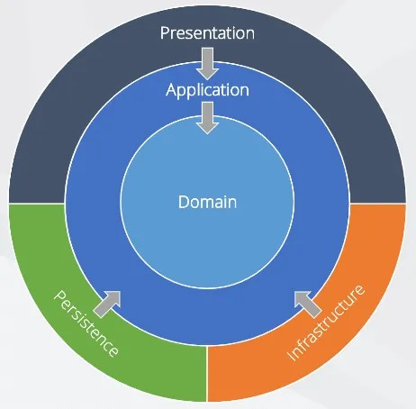
Dot NET Architectural Overview

Slide 7
Dot NET Design Patterns & Principles

Slide 8
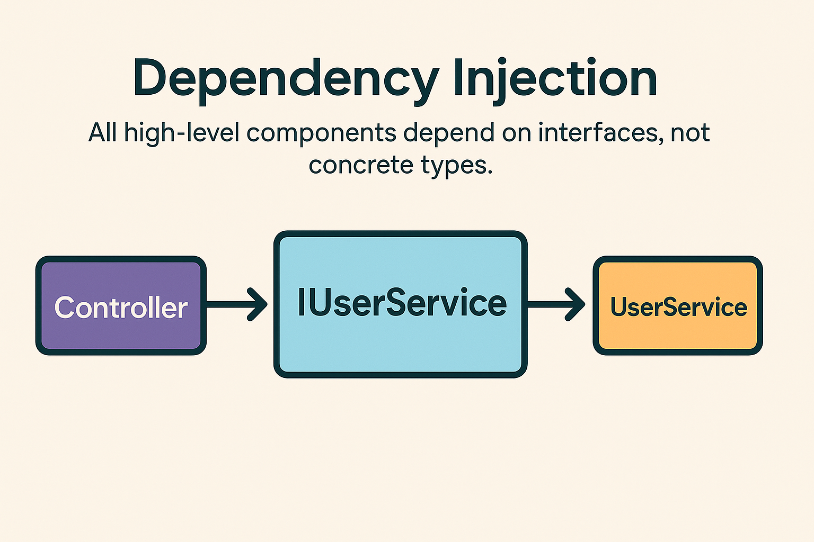
Dependency Injection
All high-level components depend on interfaces, not concrete types.

Slide 9
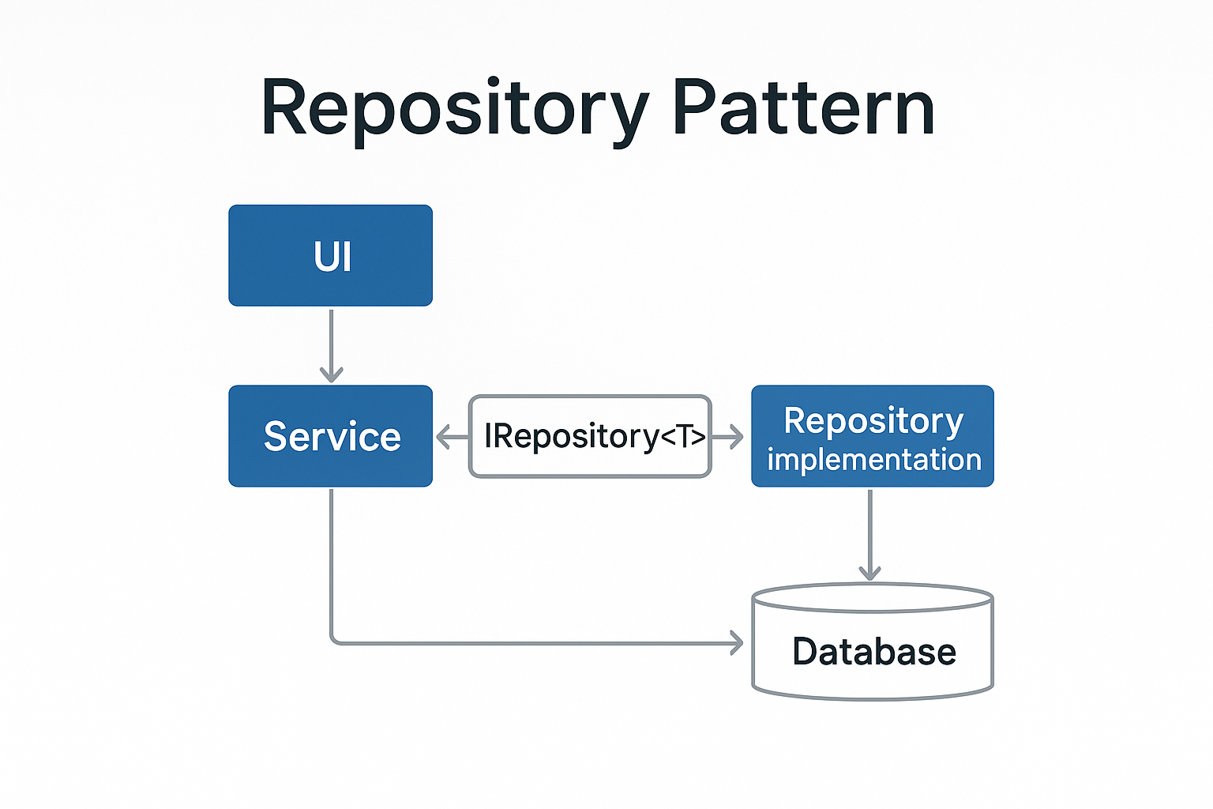
Repository Pattern
public class UserRead : IReadUsers
{
// uses EF Core underneath but
// Application layer only sees IUserRead
}

Slide 10
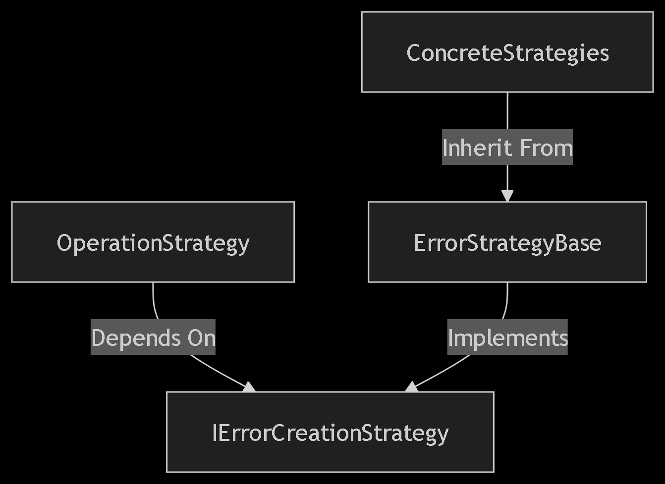
Strategy Pattern
All high-level components depend on interfaces, not concrete types.

Slide 11
Template Method
All high-level components depend on interfaces, not concrete types. in abstract repositories (CreateRepository<T>, UpdateRepository<T>) to wrap common flow and allow subclasses to override only CreateEntity / UpdateEntity.

Slide 12
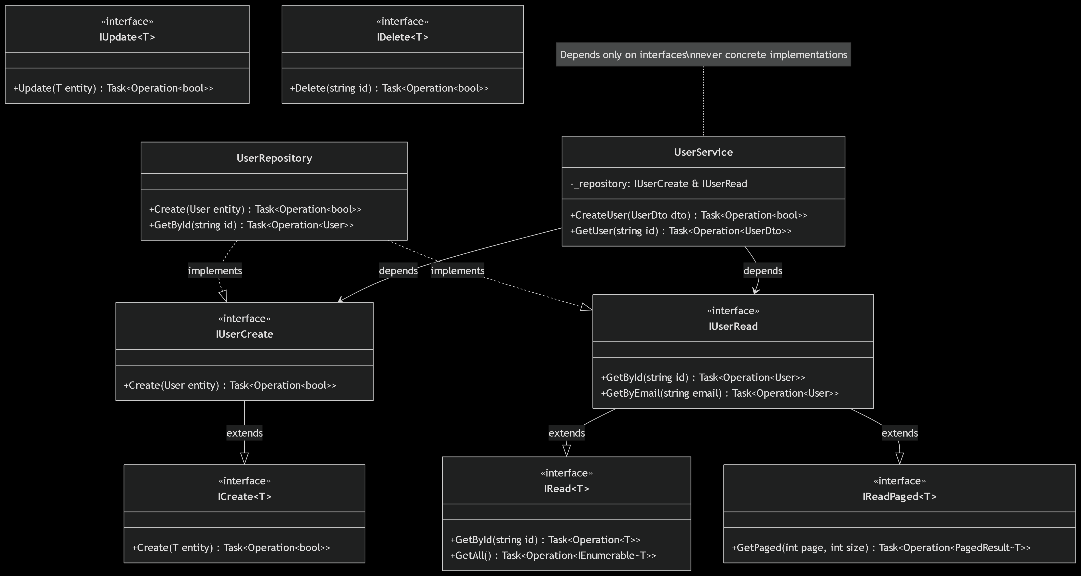
CQRS-lite
Separate interfaces for Create/Read/Update/Delete (IUserCreate, IUserRead, etc.)

Slide 13
SOLID
SRP: Each class has a clear responsibility (e.g. SqliteFunctionInterceptor only registers DB functions).
OCP: Easy to extend new use-cases or error strategies without modifying existing code.
LSP: Derived repository classes honor the base contracts.
ISP: Interfaces are narrow (CRUD-specific).
DIP: High-level modules (Controllers) rely on abstractions.

Slide 14
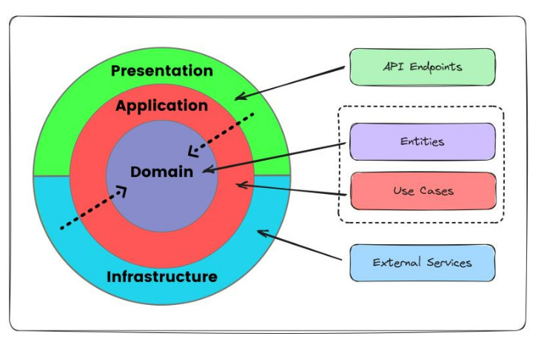
Domain-Driven Design (DDD)
Entities with identity (Id) and invariants (via DataAnnotations).
No anemic domain is present—most logic lives in Application/Infrastructure, so you could push more behavior into Domain if desired.

Slide 15
Infrastructure & Integrations

Slide 16
ORM & Persistence
Entities with identity (Id) and invariants (via DataAnnotations).
DbFunction interceptor registers an ordinal string comparison for cursor-based paging.
Migrations in Autodesk.Api.Migrations for schema evolution.

Slide 17
Caching
IMemoryCache in UserRead.GetUsersPage(...) to cache paged results for 5 minutes.

Slide 18
External Services
HttpClientFactory for outbound HTTP calls (builder.Services.AddHttpClient()).
Swagger for API documentation.

Slide 19
External Services
HttpClientFactory for outbound HTTP calls (builder.Services.AddHttpClient()).
Swagger for API documentation.

Slide 20
Scalability & .NET Best Practices

Slide 21
Asynchronous All the Way
All I/O (DB, cache, HTTP) uses async/await, preventing thread-pool starvation.

Slide 22
Performance Recommendations
Batching: Consider IAsyncEnumerable<T> for very large result sets.
Distributed Cache: Migrate MemoryCache → RedisCache for load-balanced environments.
Health Checks & Metrics: Add Microsoft.Extensions.Diagnostics.HealthChecks and Prometheus/App Metrics.
Logging: Use structured logging (ILogger<T>) rather than Console.WriteLine.

Slide 23
Questions

Slide 24
Thank You

